Slide 1
Year 10 PreATAR Science
Meiosis and gamete formation

Slide 2
Phase Diagram
I
P
M
A
T

Slide 3
True or false
A chromosome contains 2 copies of identical DNA
During interphase, DNA is duplicated
During prophase the nuclear membrane forms.
During metaphase, spindle fibres pull apart each chromatid (piece of DNA)
During anaphase, chromosomes are not able to be seen.

Slide 4
True or false
During telophase, two new nuclei form.
The products of mitosis are identical to each other and the original cell
Mitosis is used for the production of eggs and sperm.
The full set of DNA/chromosomes is called the diploid number.
The centromere is responsible for the production of spindle fibres.

Slide 5
Learning Intentions
recognising that genetic information passed on to offspring is from both parents by meiosis and fertilisation

Slide 6
Objectives
Find the main differences between mitosis and meiosis
number of chromosomes
number of cells produced
where it happens
why it happens

Slide 7
Key words
diploid / haploid
gametes / somatic cells
fertilisation
reduction division

Slide 8
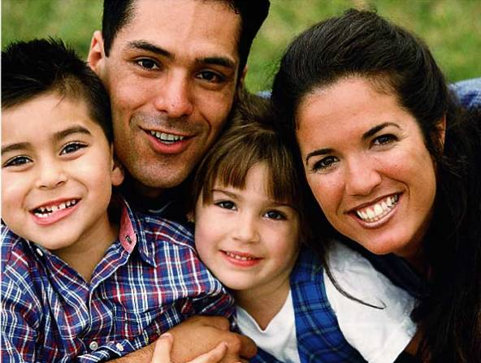
Why do you share some but not all characteristics of each parent?

Slide 9
Meiosis does two things
Meiosis takes a cell with two copies of every chromosome (diploid)and makes cells with a single copy (haploid)
This is a good idea if you’re going to join it with another cell to make a new human
In meiosis, one diploid cell produces four haploid cells

Slide 10
Why do we need meiosis?
Meiosis is necessary to halve the number of chromosomes going into the sex cells
Why halve the chromosomes in gametes?
At fertilization the male and female sex cells will provide ½ of the chromosomes each – so the offspring has genes from both parents

Slide 11
Meiosis scrambles the specific forms of each gene that each sex cell (egg or sperm) receives.
This makes for a lot of genetic diversity. This trick is accomplished through independent assortment and crossing-over.
Genetic diversity is important for the evolution of populations and species.

Slide 12
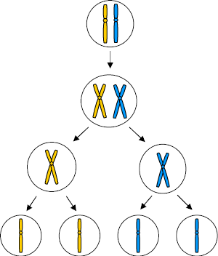
Meiosis
Parent cell – chromosome pair
Chromosomes copied
1st division - pairs split
2nd division – produces 4 gamete cells with ½ the original no. of chromosomes

Slide 13
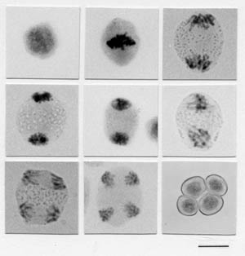
Meiosis – mouse testes
Parent cell
1st division
2nd division
4 gametes

Slide 14
Meiosis:
Also known as Reduction Division ie it reduces the number of chromosomes as it divides.

Slide 15
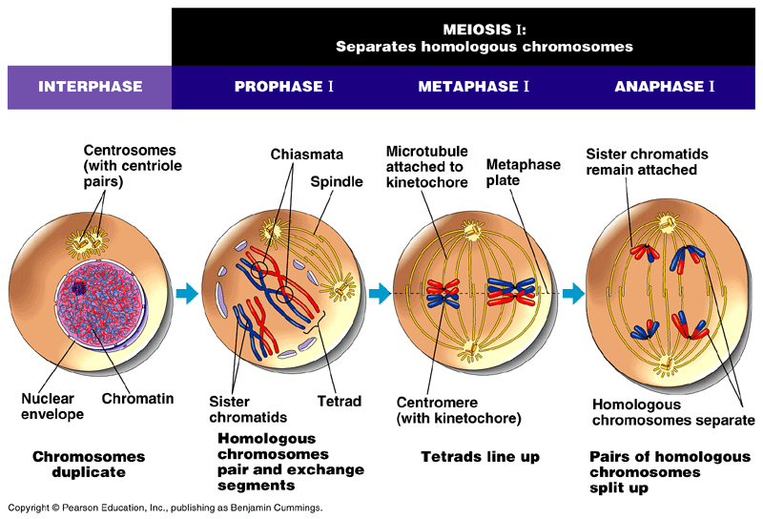
Figure 13.7 The stages of meiotic cell division: Meiosis I

Slide 16
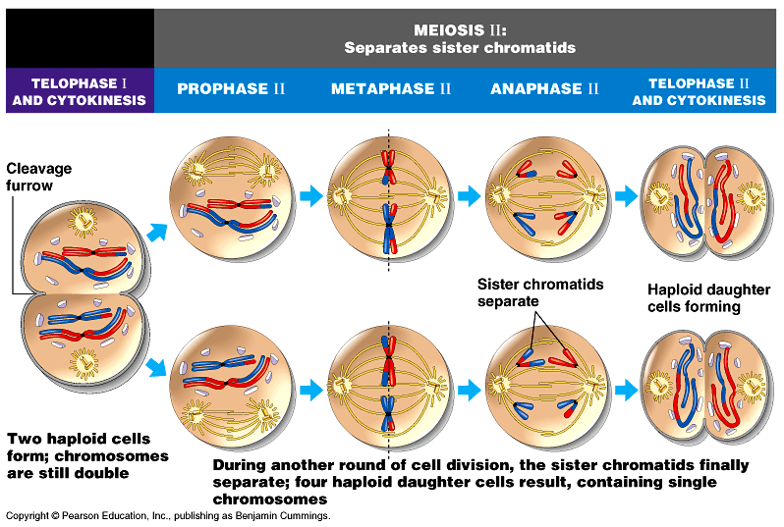
Figure 13.7 The stages of meiotic cell division: Meiosis II

Slide 17
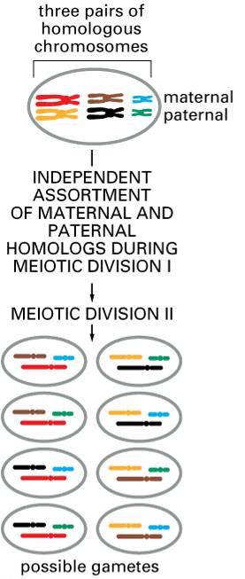
One Way Meiosis Makes Lots of Different Sex Cells (Gametes)
– Independent Assortment
Independent assortment produces 2^{n} distinct gametes, where n = the number of unique chromosomes.
In humans, n = 23 and 2²³ = 8,388,608.
That’s a lot of diversity by this mechanism alone.

Slide 18
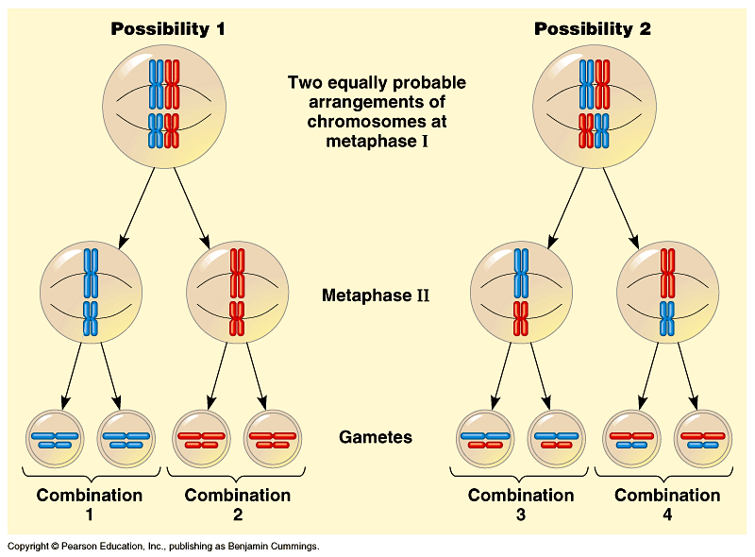

Slide 19
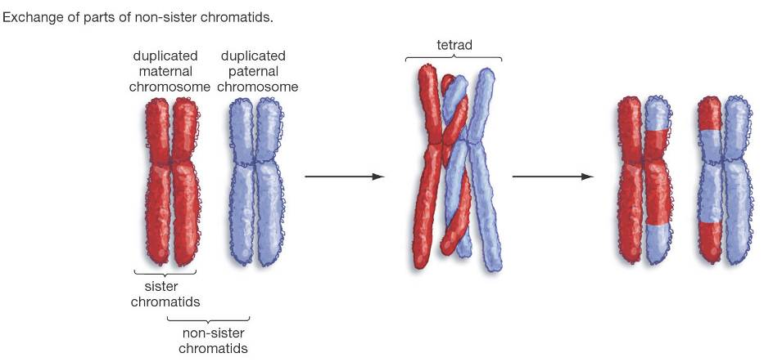
Another Way Meiosis Makes Lots of Different Sex Cells – Crossing-Over
Crossing-over multiplies the already huge number of different gamete types produced by independent assortment.

Slide 20
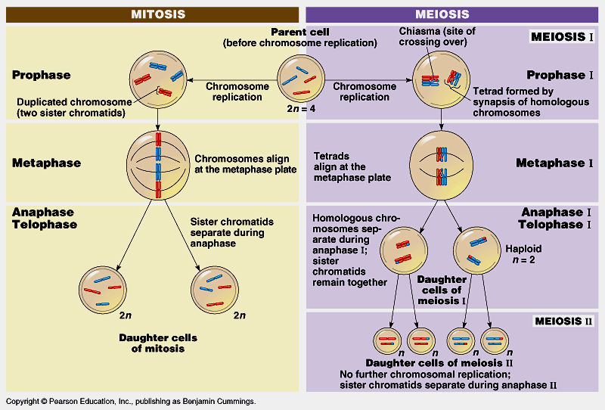
Mitosis vs. Meiosis

Slide 21
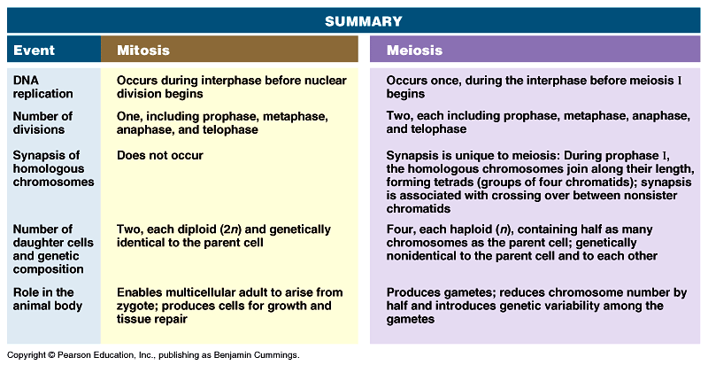
Mitosis vs. Meiosis

Slide 22
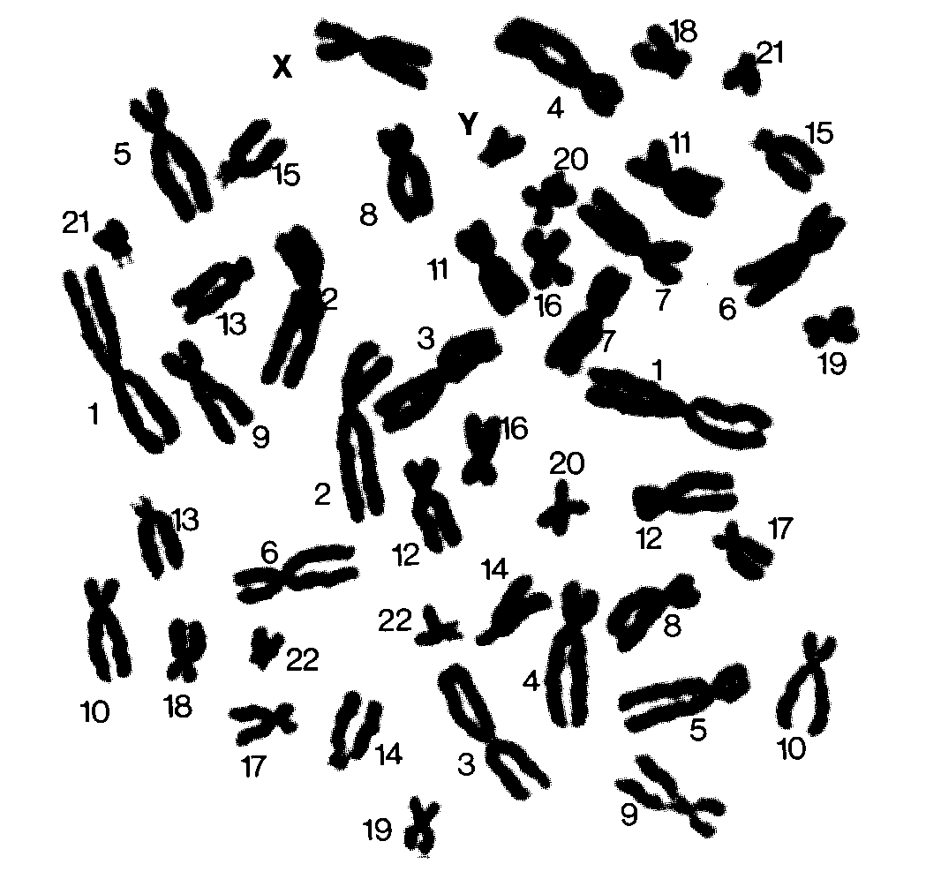

Slide 23
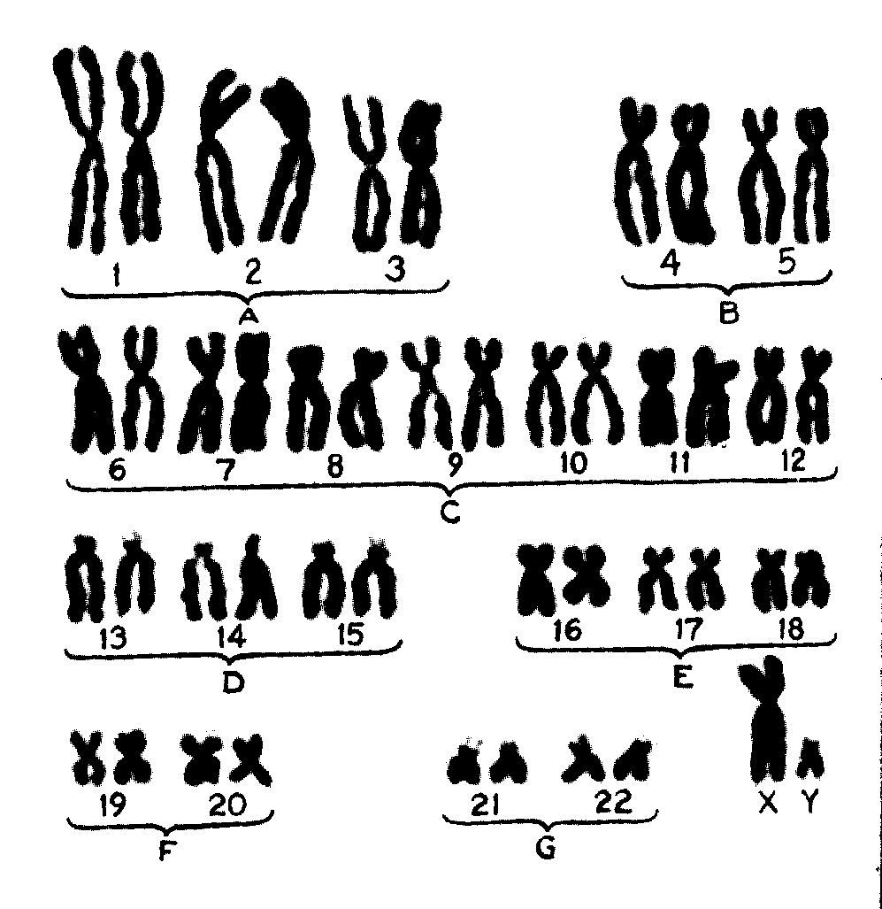

Slide 24
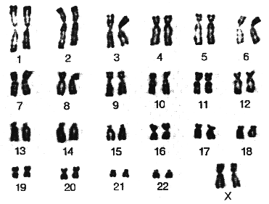

Slide 25
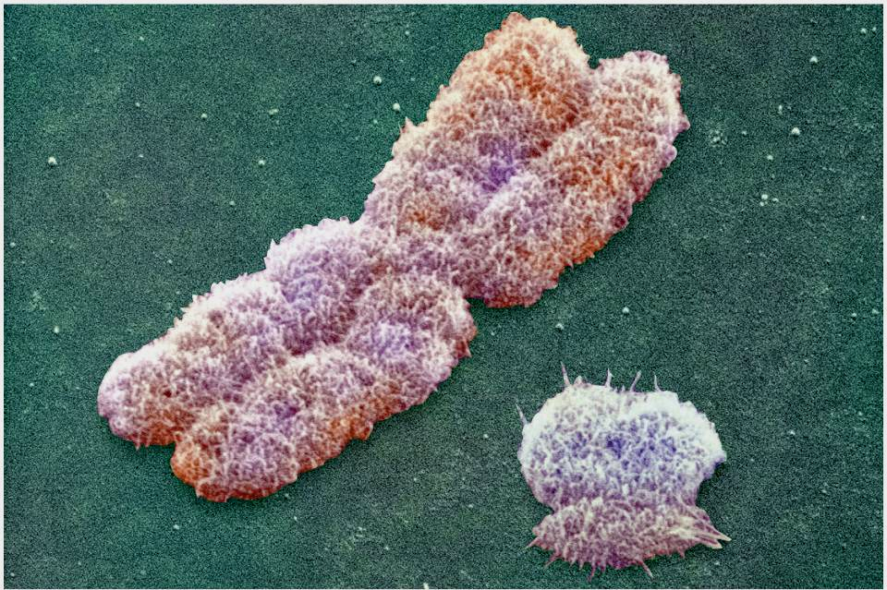
Male or female? The Y Chromosome “Decides”
Y chromosome
X chromosome

Slide 26
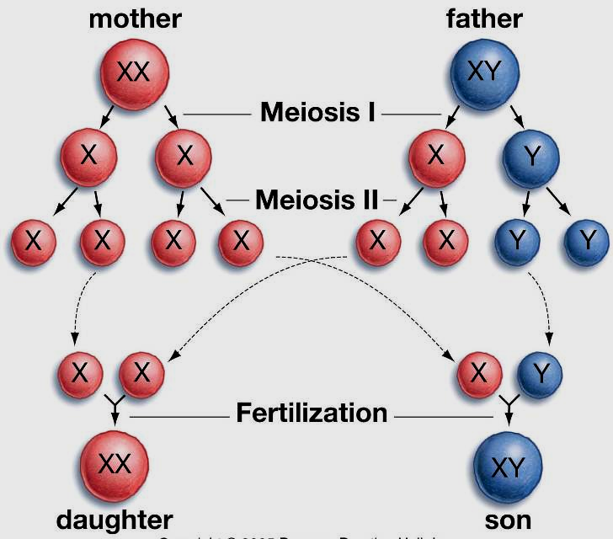
Boy or Girl? The Y Chromosome “Decides”

